Slide 1


DESIGN 1
Lesson 3: Independent Application: Images on Every Page
Ms. Abboud • Grade 9 - Design 1 • Term 1, Week 6

Slide 2
Learning Objectives
WALT - We Are Learning To
WILF - What I'm Looking For
Add purposeful images to every page of the F1 website.
Every page of my F1 website has at least one image.
All images are in the images folder and display correctly.

Slide 3
Frayer Model: Image Tag (img) (Review)
DEFINITION
CHARACTERISTICS
The self-closing <img> tag used to embed a picture in a webpage.
Self-closing; needs src and alt; no closing tag.
IMAGE TAG (IMG)
EXAMPLES
NON-EXAMPLES
<img src="images/pit-stop.jpg" alt="An F1 team practising a pit stop">
<a>; <p> (these need closing tags).

Slide 4
National Identity Integration
UAE Landmarks and Tourism: Yas Marina Circuit on Yas Island hosts the Abu Dhabi Grand Prix and welcomes visitors from around the world. Good images on a website help people picture a place before they visit.

Slide 5
STARTER
Which Pages Need a Picture?
Open your F1 website.
Which pages still have no picture?
Hook • Engage & Ask
5 - 10 minutes

Slide 6
LESSON CORE
I Do: Today's Challenge
Contact Us gets yas-marina-circuit.jpg; Vision and Mission gets pit-stop.jpg.
You write the code and your own alt text. Stretch: an image that is also a link.
Gradual Release of Responsibility
30 - 40 minutes
Stretch: an image that links back to Home
<a href="index.html">
<img src="images/f1-race-start.jpg" alt="Back to Home" width="150">
</a>
1 / 2

Slide 7
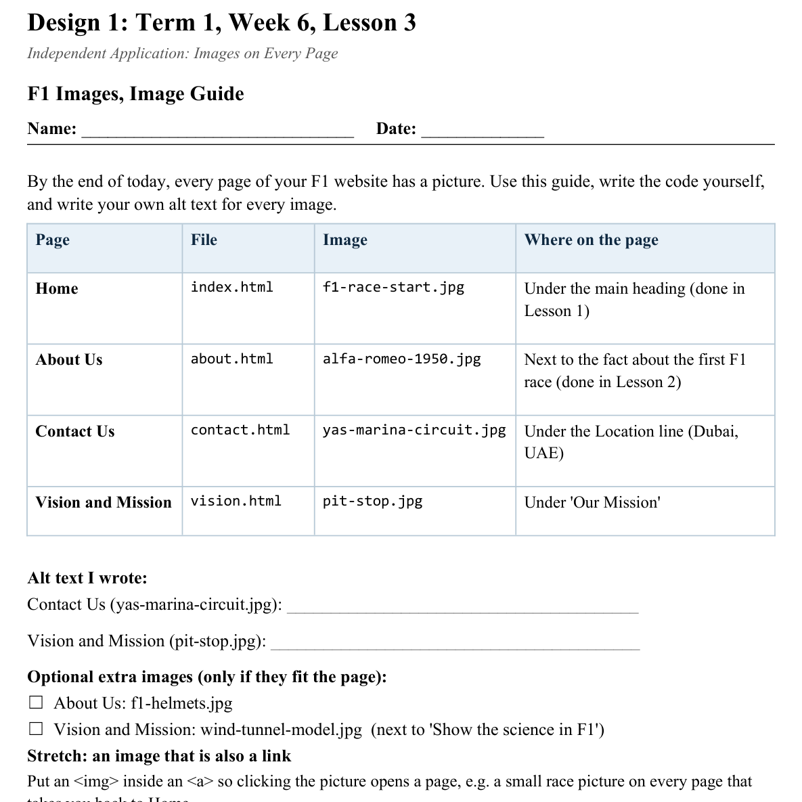
LESSON CORE
You Do: Images on Every Page
Follow the Image Guide for Contact Us and Vision and Mission.
I'll be circulating to check image choices, sizes and your images folder.
Activity: F1 Images, Image Guide
Gradual Release of Responsibility
30 - 40 minutes
2 / 2

Slide 8
CLOSURE
Teacher Circulation
No formal exit ticket today. Teacher circulates for 1:1 feedback.
Transition & Extend
5 - 10 minutes

